Slide 1
SafetyEye – AI-Powered Workplace
Occupancy & Safety Monitor

Slide 2
TABLE OF CONTENTS
INTRODUCTION
OBJECTIVE & OUTCOMES
DATASET OVERVIEW AND KEY INSIGHTS
METHODOLOGY
DATA PREPARATION
RULE & VIOLATION ENGINE
MODEL TRAINING
TRAINING AND EVALUATION
RESULTS
VISUALIZATION
USER INTERFACE & ALERT SYSTEM
CHALLENGES
FUTURE SCOPE
CONCLUSION

Slide 3
INTRODUCTION
SafetyEye is an AI-powered safety monitoring system that helps industries ensure workers follow safety rules at the workplace.
It uses CCTV or video feeds along with deep learning (YOLOv8) to detect if workers are wearing required safety equipment like helmets, vests, and masks.
The system can automatically find safety violations, send alerts, and record evidence, helping supervisors take quick action.
It works in real time, even in different lighting or motion conditions, and aims to make workplaces safer, smarter, and more efficient through AI technology.

Slide 4
OBJECTIVE
To develop an AI-powered workplace safety monitoring system that can automatically detect Personal Protective Equipment (PPE) compliance and violations such as missing helmets, vests, or masks in real time using YOLOv8 deep learning architecture.
OUTCOMES
An integrated deep learning system capable of PPE detection and violation monitoring.
Improved accuracy and reliability under real-world scenarios (day/night/motion).
Automated safety logging and alert system with low-latency performance.

Slide 5
DATASET OVERVIEW AND KEY INSIGHTS
Dataset Source: [Construction Site Safety Image Dataset Roboflow]
(https://www.kaggle.com/datasets/snehilsanyal/construction-site-safety-image-dataset-roboflow)
Format: YOLO (Images + Labels)
Total Images: ~4,500 (Train, Validation, Test Combined)
Classes: Hardhat, Safety Vest, Mask, No-Hardhat, No-Mask, No-Vest, Person, Vehicle, Machinery, Safety Cone
Split:
Train: 2603
Validation: 114
Test: 82
Insights:
Diverse workplace environments
Imbalanced samples for some PPE types (e.g., masks, gloves)
Requires robust model generalization for low-light and motion blur scenarios

Slide 6
METHODOLOGY
Safety Eye follows a 5-stage modular workflow:
Data Preparation Cleaning and organizing dataset in YOLOv8 format
Model Training YOLOv8-based PPE Detection
Rule Engine Violation Logic for PPE Compliance
Alert System Real-Time Notifications (Console / Email / GUI)
Dashboard Integration Streamlit-based Visualization and Analytics

Slide 7
DATA PREPARATION
Collected and organized the dataset in YOLOv8 format (images +label files).
Removed duplicate, corrupted, and mislabeled images.
Verified bounding boxes using visualization scripts.
Performed data augmentation (flip, blur, brightness/contrast, rotation).
Normalized all images to 640×640 resolution for model compatibility.
Prepared data.yaml with class names and dataset paths.
Feature Extraction
Model uses Convolutional Layers (CNN backbone) for feature maps
Extracts spatial patterns of PPE items such as helmets and vests
YOLOv8 provides end-to-end feature extraction, bounding box regression, and classification
High-level features used for rule-based PPE classification and violation detection

Slide 8
RULE & VIOLATION ENGINE
Applies safety rules on top of YOLOv8 detections to check PPE compliance.
Evaluates each detected person for required safety gear:
Helmet
Safety Vest
Mask
Uses per-person logic to identify:
No Helmet
No Vest
No Mask
Uses 3-frame confirmation to avoid false alerts due to flicker or motion blur.
Labels each person with Green (Compliant) or Red (Violation) overlays.
Supports multiple workers in the same frame with separate IDs.

Slide 9
MODEL TRAINING
Trained PPE detection model using YOLOv8 architecture.
Used GPU acceleration for faster training and improved performance.
Model learned to detect: Helmet, Vest, Mask, No-Helmet, No-Vest, No- Mask, Person, etc.
Tuned training parameters for better precision and recall:
Epochs: 50
Batch Size: 16
Image Size: 640
Learning Rate: 0.005
Monitored loss curves and validation accuracy throughout training.
Saved best weights (best.pt) based on highest mAP.

Slide 10
TRAINING AND EVALUATION
Model trained with YOLOv8 using GPU acceleration
Real-time testing on multiple construction site videos
Evaluated using:
Precision, Recall, F1-Score, and mAP
Average FPS for inference speed
Model Performance:
Average FPS: 25–30
Avg Inference Time: 40 ms per frame
Device: NVIDIA RTX 3060

Slide 11
RESULTS
Input | Detection Quality | Frame Rate | Observation
webcam_feed | High | 26 FPS | Smooth detection, stable bounding boxes
test_day.mp4 | Moderate | 23 FPS | Accurate detections, minor false positives
test_night.mp4 | Low | 18 FPS | Missed vest under low light
demo_site.mp4 | High | 25 FPS | Consistent, multi-person tracking
Reliable performance across lighting conditions
Violation detection stable across frames
Real-time alerts functional and accurate

Slide 12
VISUALIZATION
Input | Observation | Detection Quality
test1.jpg | Helmet and Vest detected accurately | High
test2.jpg | Gloves missed due to low contrast | Moderate
site_demo.mp4 | Smooth tracking across frames | Good
test_night.mp4 | Few missed detections under shadows | Fair
Performance Metrics:
Metric | Value
Precision | 0.855
Recall | 0.714
mAP50 | 0.786
mAP50-95 | 0.466

Slide 13
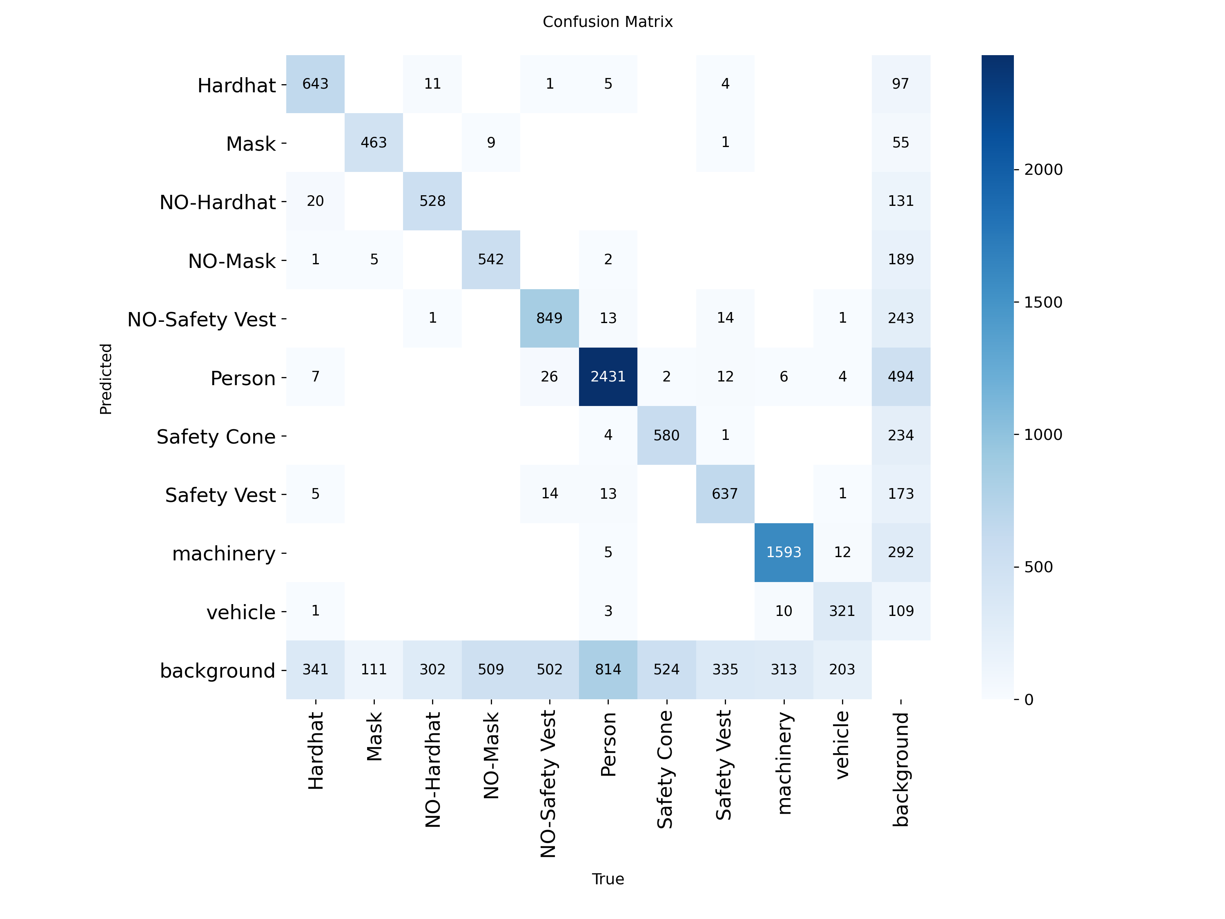

Slide 14
USER INTERFACE & ALERT SYSTEM
Features
Displays live camera or video feed
Overlays bounding boxes (Green for PPE, Red for violations)
Real-time alert messages displayed in console or email
Option to integrate with Streamlit dashboard
Performance Example:
Input | FPS | Observations
Webcam Feed | 26 | Smooth detection
Site Day | 23 | Minor false positives
Site Night | 18 | Missed vest in low light

Slide 15
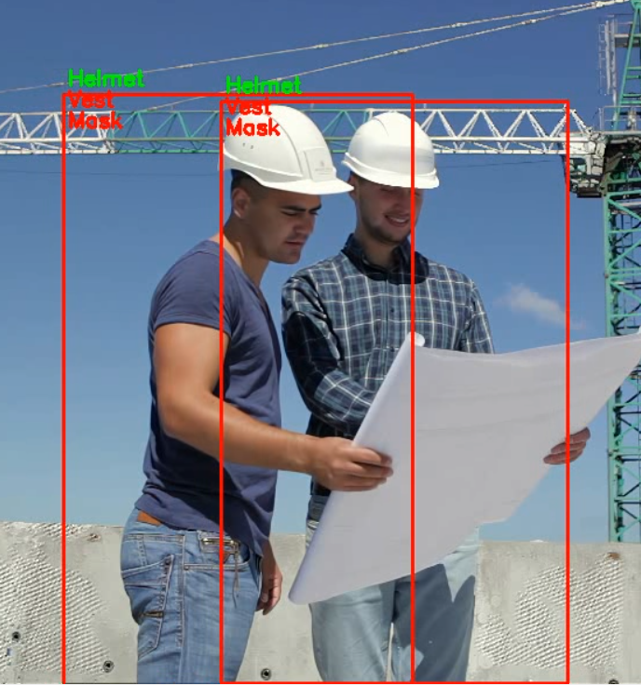
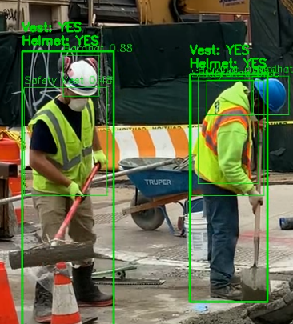
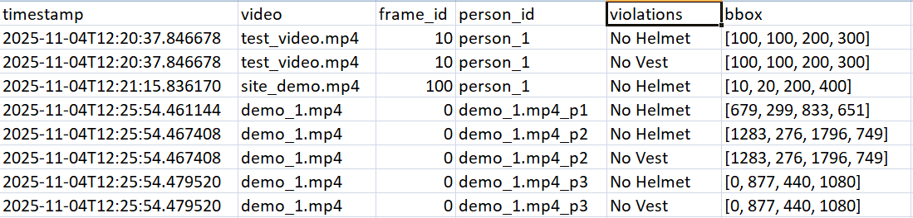

Slide 16
CHALLENGES
1 Data Imbalance Some PPE classes (e.g., Gloves, Mask) had fewer samples than others, affecting recall.
2 Low-Light Detection Poor lighting and shadow regions caused misclassification.
3 False Positives Occasional false “No Helmet” detections during motion blur.
4 Performance Optimization Balancing real-time FPS and accuracy required careful tuning (frame skip, FP16, batch size).

Slide 17
FUTURE SCOPE
Expand dataset for rare PPE types (gloves, face shield).
Implement Streamlit Dashboard for live analytics and reports.
Enable Edge Deployment on NVIDIA Jetson / Raspberry Pi.
Introduce Worker Re-Identification (Re-ID) for long-term tracking.
Add Cloud Alert Integration for centralized safety monitoring.

Slide 18
CONCLUSION
The SafetyEye Project successfully demonstrates the potential of deep learning-based vision systems in enforcing workplace safety standards. Through the integration of YOLOv8 detection, rule-based violation analysis, and alert-driven automation, the system provides:
Real-time PPE detection and compliance verification
Automated violation alerts and video evidence logging
Reliable performance under diverse conditions
Foundation for industrial-grade AI safety solutions

Slide 19
ACKNOWLEDGMENT
Infosys Springboard Internship (Oct–Nov 2025)
Student: Uppalapati Venkata Ashok Adithya
Project: SafetyEye – AI-Powered Workplace Occupancy & Safety Monitor
Tools: Python, PyTorch, YOLOv8, OpenCV, Streamlit, Pandas, NumPy
Domain: Computer Vision & Deep Learning

Slide 20


